Slide 1


Fundamentals of Data Structure
Data Structure
Dr. Pradyuman U. Jadeja
Computer Engineering Department
pradyuman.jadeja@darshan.ac.in
+91 9879461848

Slide 2
Data Structure

Slide 3
Data Structure
not directly provided by the programming language as a basic type, but is built using primitive data types
basic structures and are directly operated upon by machine instructions
Data structure is a way of organizing data.
This organization leads to efficient access and modification of data.
Data Structure
Primitive Data Structure
Non-Primitive Data Structure
Integer
Characters
Arrays
Lists
Files
Floating
Point
Pointers
Linear List
Non-Linear List
data elements are stored sequentially or linearly
data elements are not stored sequentially or linearly
Stack
Queue
Graphs
Trees

Slide 4
Types of Data Structures
Linear Data Structure
Non-Linear Data Structure

Slide 5
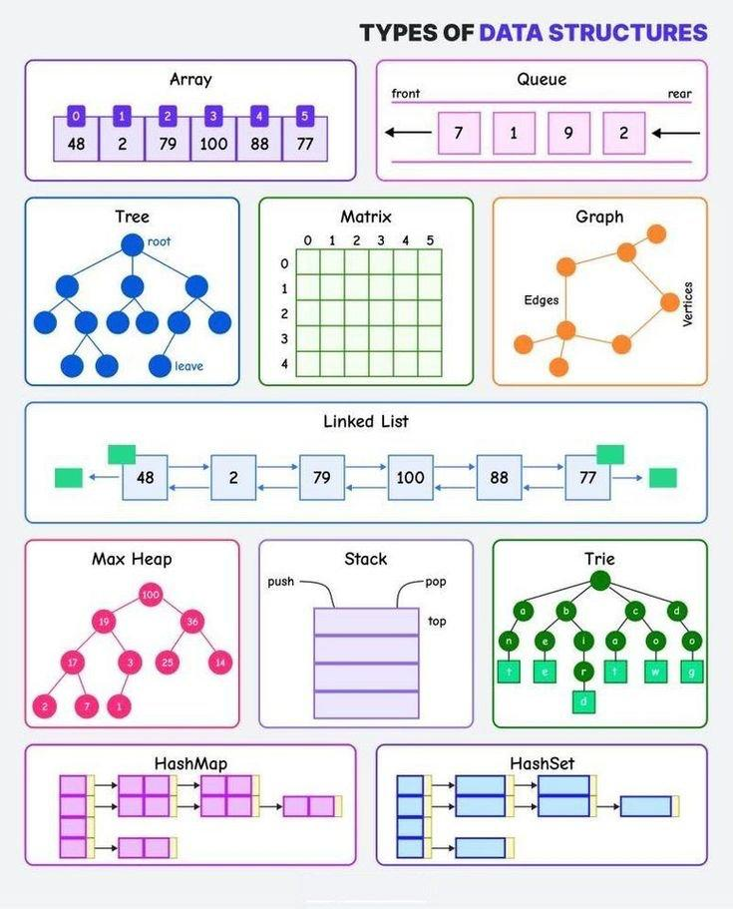
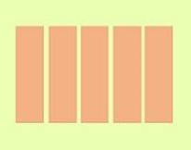
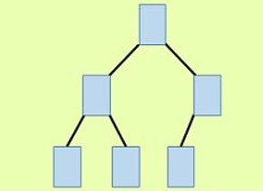
Linear Data Structures
Array(1-d, matrix)
Stack
Queue
Linked List
Non Linear Data Structures
Tree
Graph
Hash Table

Slide 6
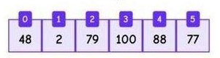
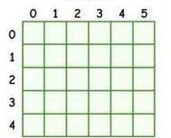
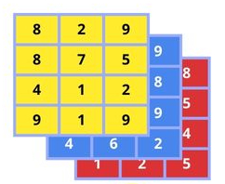
Array
Types of Array
Stores elements of same datatype in contiguous memory locations.
Array should be used, when:
we know the number of elements in advance and that don’t change.
faster access is required in O(1) complexity (using index).
Array shouldn’t be used, when:
data size changes frequently
Insertions/deletions in the middle are frequent
One
Dimensional Array
Two
Dimensional Array
Array Operations | Time Complexity
Access (by index) | O(1)
Search (unsorted) | O(n)
Search (sorted) | O(logn) – Binary Search
Insertion (end) | O(1)
Insertion (middle) | O(n)
Deletion (end) | O(1)
Deletion (middle) | O(n)
Multi
Dimensional Array
In case of dynamic array

Slide 7
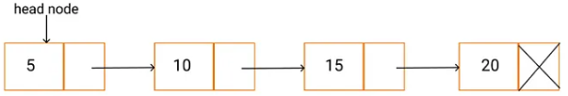
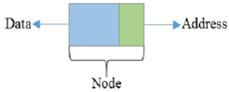
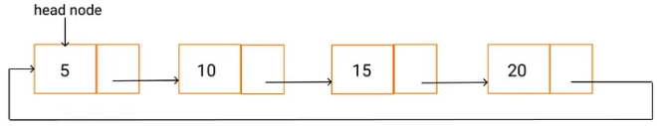
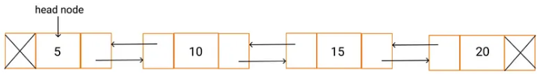
Linked List
Types of Linked List
Linked list is a linear data structure where each element (known as node) contains:
Data
Address of the next node
Singly Linked List
Linked list Operations | Time Complexity
Insert at the beginning Delete first node | O(1)
Insert at the end Insert at given position Delete last node Delete the given nod | O(n)
Search | O(n)
Access Traverse | O(n)
Circular Linked List
Doubly Linked List

Slide 8
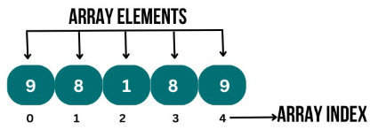
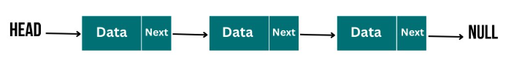
Array vs Linked List
Array
Linked List
Elements are stored in contiguous memory location
Size is fixed : static memory allocation
Insertion/deletion are costly : elements need to be shifted
Fast random access
Compact memory usage
Elements are connected using pointers
Dynamic memory allocation at runtime
Insertion/deletion are done efficiently without shifting
Only supports sequential access to elements
Extra memory is required to store address

Slide 9
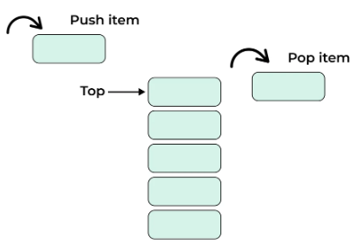
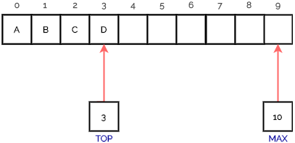
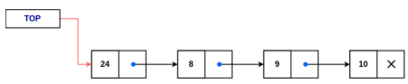
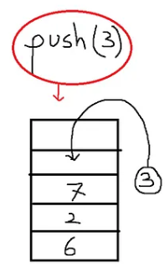
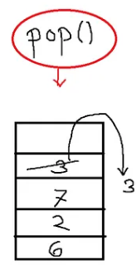
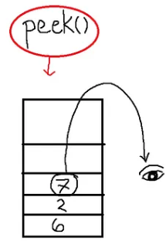
Stack
Stack is a linear data structure that follows Last In First Out(LIFO) principle.
Elements are added/removed from one end only, known as Top.
Stack can be implemented using both : Array & Linked List.
Key Operations:
Applications:
Undo/Redo functionality in text editor
Evaluating expressions
Parenthesis checking
Syntax parsing
Function call management is Recursion
Web browser history
Reversing data
Limitations:
Limited access & capacity
Not suitable for random access
Potential for overflow
Time complexity : O(1)
Array representation
Linked representation

Slide 10
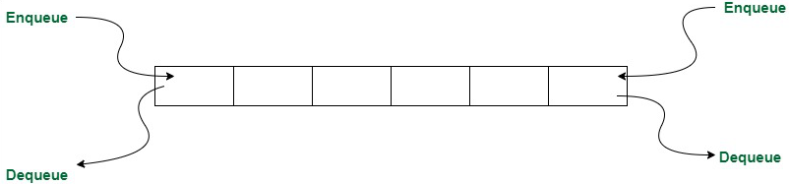
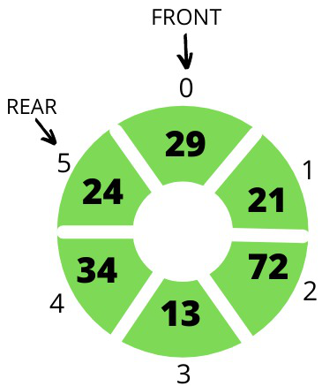
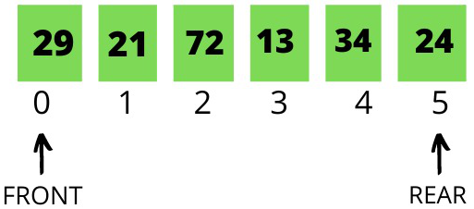
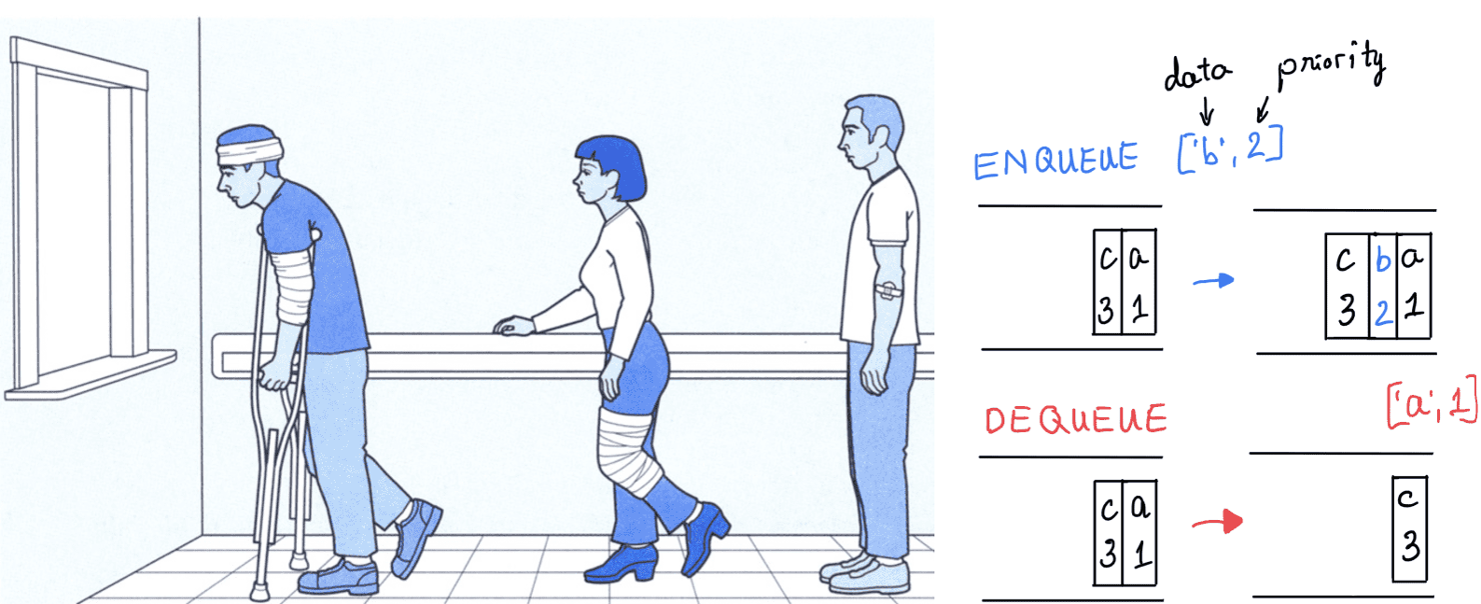
Queue
A queue is a linear data structure that follows the First In First Out(FIFO) principle.
enqueue() : operation of adding an element at REAR
dequeue() : operation of removing an element from FRONT
Types of Queue :
Applications:
Task scheduling
CPU scheduling in operating system
Traffic management system
Network Data Packet handling
Double Ended Queue
Priority Queue
Simple Queue
Circular Queue

Slide 11
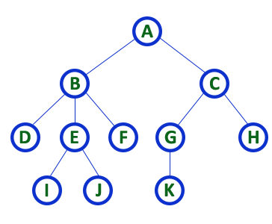
Tree
Tree is a non-linear data structure in which a collection of elements(nodes) are connected to each other via edges, such that there exists exactly one path between any two nodes. (No cycle).
Tree is used to store information that naturally forms a hierarchy.
For example: File system on a computer.
Type of trees:
Binary Tree : each node has at most two children
Traversals : Inorder, Preorder and Postorder
Binary Search Tree :
data of Left-subtree < data of Root < data of right-subtree
AVL Tree : (Self Balancing BST, also known as height balanced tree)
B-Trees : (used in databases for indexing)
Heap :(complete binary tree used in Priority queue)
Tree

Slide 12
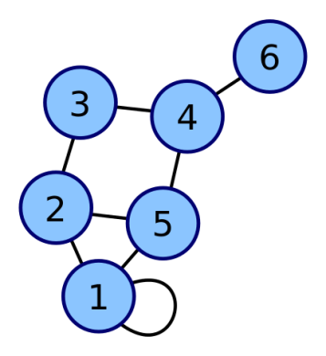
Graph
Graph is a non-linear data structure, consisting of nodes(vertices) and edges.
Graph can be represented using:
Adjacency Matrix : uses 2-D array
Adjacency List : uses array of lists
Graph traversal algorithms:
Breadth First Search (BFS) : level wise traversal (implemented using queue)
Depth First Search (DFS) : explores the path as deep as possible, then backtrack (implemented using stack)
Graph are used :
In social networks, to show mutual connections. Users are nodes, “follows” are edges.
In AI/ Game Development/ robotics to find the optimal path from start point to goal point.
In navigation systems/ maps, to:
Find Shortest path
Get the traffic updates and rerouting
Graph

Slide 13
Hashing & Hash Function
Sequential search requires, on the average O(n) comparisons while Binary search requires much fewer comparisons on the average O (log₂n) but the data should be sorted.
Hashing is a technique used in data structure to efficiently store and retrieve data.
Hash Table : is the fixed size array where the data (record : key, value) is stored
Hash Function : Takes key of a record as an input and returns an index of the hash table to store that record.
The goal is to distribute keys evenly across the table to minimize Collisions.
Collision occurs when two distinct keys are assigned the same index by the hash function.
This collision should be resolved using Collision Resolution Techniques (CRT).
Record : (key , value)
Hash Table
0
1
2
3
4
f()→Address
Hash Function
Mapping of Key in Hash Table

Slide 14
File Structure
A file is a collection of records where a record consists of one or more fields. Each contains the same sequence of fields. Each field is normally of fixed length.
A sample file with four records is shown below:
File Organizations:
Sequential Access File : stores and accesses data records in a fixed linear order, one after another
Direct Access File : allows data records to be accessed directly using a calculated address or key, without reading through other records sequentially (uses hashing)
Indexed Sequential File : combines sequential and direct access by maintaining an index for fast searches and storing records in a sorted order for efficient sequential access.
Name | Roll No. | Year | Marks
AMIT | 1000 | 1 | 82
KALPESH | 1005 | 2 | 54
JITENDRA | 1009 | 1 | 75
RAVI | 1010 | 1 | 79
There are four records.
There are four fields (Name, Roll No., Year, Marks)
Records can be uniquely identified on the field 'Roll No.' Therefore, Roll No. is the key field.
A database is a collection of files.

Slide 15
Complexity of Algorithms
Algorithm is the sequence of steps to solve a problem.
From many algorithms available to solve the problem, a programmer should choose the efficient one.
An efficient algorithm is one that solves a problem correctly and uses the least possible amount of resources, especially time and memory (space), as the input size grows.
Time complexity of an algorithm estimates the amount of time taken by an algorithm to run as a function of the length of the input.
Space complexity of an algorithm estimates the amount of space or memory taken by an algorithm to run as a function of the length of the input.
Types of time complexity by case analysis:
Best case: The time taken when the input is in the most favorable condition. (Big- Ω Notation)
Worst case: The time taken when the input is in the least favorable condition. (Big-O Notation)
Average case: The expected time taken for typical inputs, assuming a random distribution. (Big Ꝋ Notation)

Slide 16
Sorting Algorithms : Complexity comparison
Sorting Algorithm | Best Time | Average Time | Worst Time | Stable? | When to use?
Bubble Sort | O(n) | O(n²) | O(n²) | Yes | Very small datasets Data is already mostly sorted Stable and in-place algorithm is required
Insertion Sort | O(n) | O(n²) | O(n²) | Yes | Small datasets Partially sorted data
Selection Sort | O(n²) | O(n²) | O(n²) | No | Very small datasets
Merge Sort | O(n log n) | O(n log n) | O(n log n) | Yes | When stable sort is required Sorting linked lists Large datasets
Quick Sort | O(n log n) | O(n log n) | O(n²) | No | Large, unsorted datasets
Heap Sort | O(n log n) | O(n log n) | O(n log n) | No | Limited memory; guaranteed O(n log n) worst-case time
Counting Sort | O(n + k) | O(n + k) | O(n + k) | Yes | Sorting integers within a small known range
Radix Sort | O(nk) | O(nk) | O(nk) | Yes | Sorting large numbers with fixed-length keys
Bucket Sort | O(n + k) | O(n + k) | O(n²) | Yes | Sorting uniformly distributed floating-point numbers

Slide 17

Linked List : Programming Aspect
Data Structure
Dr. Pradyuman U. Jadeja
Computer Engineering Department
pradyuman.jadeja@darshan.ac.in
+91 9879461848

Slide 18
Linked List
A linked list is a linear data structure where elements (called nodes) are stored in non-contiguous memory and connected using pointers.
Each node has two parts:
Data - stores the actual value.
Pointer - stores the address of the next node.
Types of Linked List:
Singly Linked List
Circular Linked List
Doubly Linked List
NULL Value
Last Node
A
1000
B
2050
C
3335
D
5000
1000
2050
3335
A linked List

Slide 19
Node Structure of Singly Linked List
Info
Link
Accessing Part
of Node
Info (Node)
Link (Node)
NOTE
Typical Node
Node
Node structure of Circular Linked List will be same.
The only change is :
the last node of the list will store the address of the first node of the list, rather than having null.
Data
Pointer to Next Node
struct node
{
int info;
struct node *link;
};
C Structure to represent a node

Slide 20
Node Structure of Doubly Linked List
lptr
info
rptr
Accessing Part
of Node
lptr(Node)
info(Node)
rptr(Node)
Typical Node
Node
Pointer to previous node
Data
Pointer to next node
struct node
{
struct node *lptr;
int info;
struct node *link;
};
C Structure to represent a node

Slide 21
Basic operations on Singly Linked List
Insert a node at a beginning
Insert a node at the end
Delete the first node
Delete the last node
Traverse/print the list

Slide 22
Insert a node at a beginning
void insertAtBeginning(struct node** FISRT, int new_data)
{
struct node* NEW = (struct Node*)malloc(sizeof(struct node));
NEW->info = new_data;
NEW->link = *FIRST;
*FIRST = NEW;
}
50
10
link
50
link
35
link
20
NEW
FIRST
struct node
{
int info;
struct node *link;
};

Slide 23
Insert a node at the end
void insertAtEnd(struct Node** FIRST, int data){
struct Node* NEW = (struct node*)malloc(sizeof(struct node));
NEW->info = data;
NEW->link = NULL;
if (*FIRST == NULL) {
*FIRST = NEW;
return;
}
struct node* SAVE = *FIRST;
while (SAVE->link != NULL) {
SAVE = SAVE>link;
}
SAVE->link = NEW;
}
SAVE
10
50
-1
8
35
50
NEW
FIRST

Slide 24
Delete the first node
void deleteFromFirst(struct Node** FIRST) {
if (*FIRST == NULL) {
printf("List is empty");
return;
}
struct Node* SAVE = *FIRST;
*FIRST = SAVE->link;
free(SAVE);
}
SAVE
10
link
50
link
35
link
20
FIRST

Slide 25
Delete the last node
void deleteFromEnd(struct Node** FIRST)
{
if (*FIRST == NULL)
{
printf("List is empty");
return;
}
struct Node* SAVE = *FIRST;
if(SAVE->link == NULL)
{
free(SAVE);
*FIRST = NULL;
return;
}
while (SAVE->link->link != NULL)
{
SAVE = SAVE>link;
}
free(SAVE->link);
SAVE->link = NULL;
}
Condition to check for linked list
having single node

Slide 26
Print the list
void print(struct Node* FIRST)
{
struct Node* SAVE = FIRST;
while (SAVE != NULL) {
printf("%d -> ", SAVE->info);
SAVE = SAVE->link;
}
printf("NULL");
}

Slide 27
Basic operations on Doubly Linked List
Insert a node at a beginning
Insert a node at the end
Delete the node by value
Traverse the list in forward direction
Traverse the list in backward direction

Slide 28
Insertion in Doubly Linked List
void insertAtBeginning(struct Node** FIRST, int data)
{
struct Node* NEW = (struct node*)malloc(sizeof(struct node));
NEW->info = data;
NEW->lptr = NULL;
NEW->rptr = *FIRST;
FIRST = NEW;
}
struct node
{
struct node *lptr;
int info;
struct node *rptr;
};

Slide 29
Insertion in Doubly Linked List
void insertAtBeginning(struct Node** FIRST, int data)
{
struct Node* NEW = (struct node*)malloc(sizeof(struct node));
NEW->info = data;
if (*FIRST == NULL) {
*FIRST = NEW; return;
}
struct Node* SAVE = *FIRST;
while (SAVE->rptr != NULL) {
SAVE = SAVE->rptr;
}
SAVE -> rptr = NEW
NEW->lptr = SAVE;
NEW->rptr = NULL;
}
struct node
{
struct node *lptr;
int info;
struct node *rptr;
};

Slide 30
Placement related Questions
Data Structure
Dr. Pradyuman U. Jadeja
Computer Engineering Department
Pradyuman.jadeja@darshan.ac.in
+91 9879461848

Slide 31
Program#1
You have given two string s1 and s2 , now return substring from s1 having characters that are not included in string s2. (Tark)
For example:
INPUT:
s1=DARSHAN
s2=ASH
OUTPUT:
DRN
Function RemoveCharacters(s1, s2):
Initialize an empty string result
for i from 0 to len(s1) - 1:
includeChar = true
for j from 0 to len(s2) - 1:
if s1[i] == s2[j]:
includeChar = false
break
if includeChar is true:
Append s1[i] to result
return result

Slide 32
Program#2
Find the Earliest Repeating Character.
Given a string S of length n, the task is to find the earliest repeated character in it. The earliest repeated character means, the character that occurs more than once and whose second occurrence has the smallest index. (Prominent Pixel)
For example:
INPUT:
s = "hello buddy"
OUTPUT:
l
Explanation:
l is the first element that repeats
Function FirstRepCharacter(s):
for i from 0 to len(s):
for j from 0 to i:
if s[i] == s[j]
return s[i]
return-1

Slide 33
Program#3
Check given strings are anagram or not. (RKIT)
For example:
INPUT:
String1 = "silent" String2 = "listen“
OUTPUT:
Given String is anagram
Explanation:
Two strings are called anagram, if they have:
Same characters
Same frequency of each character.
Function AreAnagram(s1, s2):
if len(s1) != len(s2):
return false
count[256] = 0 #assuming ASCII characters
for i from 0 to len(s)-1:
count[s1[i]]++
count[s2[i]- -
for each value in count:
if value != 0:
return false
return true

Slide 34
Program#4
WAP to check if a string containing parentheses is balanced, using stack. (Sampaarsh)
For example:
Function isBalanced(expression):
initialize an empty stack
for each character ch in expression:
if ch is an opening bracket (‘(‘, ‘{‘, ‘[‘):
push ch to stack
else if ch is an closing bracket (‘)’, ‘}’, ‘]’):
if stack is empty:
return false
pop the top character from the stack and store in x
if ch and x are not matching:
return false
if stack is empty:
return true
else:
return false
Input | Output
"( { [ ] } )" | true
"( { [ } )" | false
"( ( ( ) ) )" | true
"( { [ } )" | false
"[" | false

Slide 35
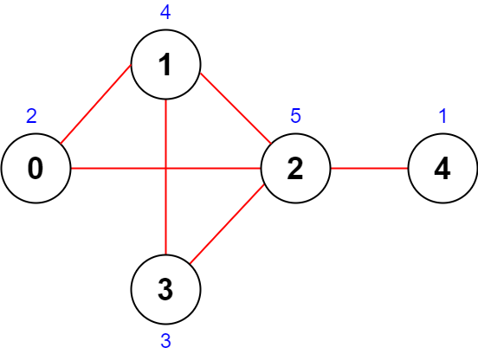
Program#4
You are given an integer n denoting the number of cities in a country.
The cities are numbered from 0 to n - 1.
You are also given a 2D integer array roads where roads[i] = [a_{i}, b_{i}] denotes that there exists a bidirectional road connecting cities a_{i} and b_{i}.
You need to assign each city with an integer value from 1 to n, where each value can only be used once. The importance of a road is then defined as the sum of the values of the two cities it connects.
Return the maximum total importance of all roads possible after assigning the values optimally.
Input: n = 5, roads = [[0,1],[1,2],[2,3],[0,2],[1,3],[2,4]]
The figure above shows the country and the assigned values of [2,4,5,3,1].
Output: 43
Explanation:
- The road (0,1) has an importance of 2 + 4 = 6.
- The road (1,2) has an importance of 4 + 5 = 9.
- The road (2,3) has an importance of 5 + 3 = 8.
- The road (0,2) has an importance of 2 + 5 = 7.
- The road (1,3) has an importance of 4 + 3 = 7.
- The road (2,4) has an importance of 5 + 1 = 6.
The total importance of all roads is 6 + 9 + 8 + 7 + 7 + 6 = 43.
It can be shown that we cannot obtain a greater total importance than 43.

Slide 36
Program#5
Write a program to print an array using recursion and without using loop and global variable. (Prominent Pixel)
How to call this function?
In main function :
arr = [10, 20, 30, 40, 50]
size = len(arr)
call printArray(arr, 0, size)
Function printArray(arr, index, size):
if index==size:
return ##base case
print(arr[index])
call printArray(arr, index+1, size)

Slide 37
Commonly asked questions
Why is it important to get the understanding of DSA, as a programmer?
What is the difference between an Array and a linked list?
How internally Linked List Work?
Explain the concept of Stack, Queue, Set, HashMap structures.
How stack is used in Recursion?
Why do need stack and queue in DFS and BFS? Difference them.
Time Complexity of different sorting algorithms & Data Structures.
Which sorting algorithm is best? Why?
How does hashing work?

Slide 38
Data Structure
Dr. Pradyuman U. Jadeja
Computer Engineering Department
pradyuman.jadeja@darshan.ac.in
+91 9879461848

